Slide 1

Exploratory Data Analysis
G2M insight for Cab Investment Firm
25nd August 2022

Slide 2

Business Problem
XYZ is a private firm in US. Due to remarkable growth in the Cab Industry in last few years and multiple key players in the market, it is planning for an investment in Cab industry.
Objective: To provide actionable insights to XYZ firm so that they can make an investment in a profitable business

Slide 3
Road Map
Business Problem
Datas Sets information
Conclusion
EDA
Multiple Hypothesis

Slide 4
Analysis steps
STEPS
1) Data Understanding and Visualization
2)Finding the maximum users cab company
3) Finding the cheapest Cab company for users
4)Finding the most profitable Cab company
5) Multiple Hypothesis and Investigate

Slide 5
Data Information
Cab_Data.csv – this file includes details of transactions for 2 cab companies.
Customer_ID.csv – this is a mapping table that contains a unique identifier that links the customer’s demographic details.
Transaction_ID.csv – this is a mapping table that contains transaction to customer mapping and payment mode.
City.csv – this file contains a list of US cities, their population, and the number of cab users.

Slide 6
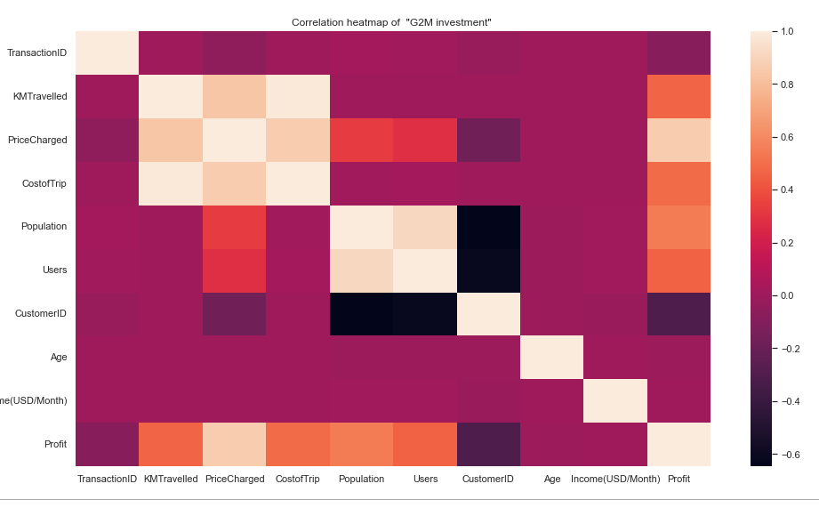
Correlation between variables
There is a strong correlation Population v/s Users, Price Charged v/s KmTravelled, Cost of Trip v/s KMtravelled
there is a correlation between Price Charged v/s Profit

Slide 7
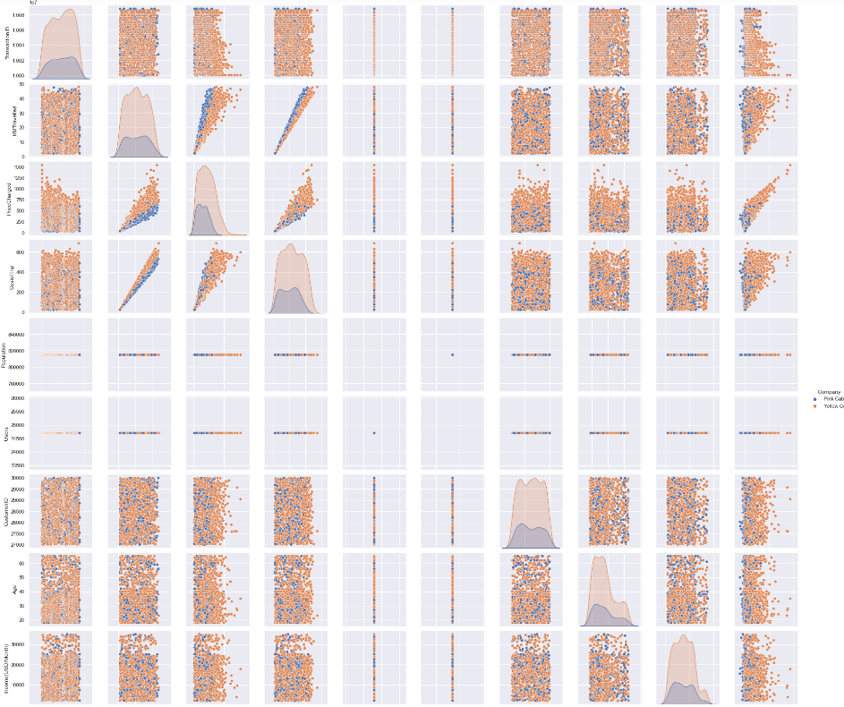
Relation ship between variables

Slide 8
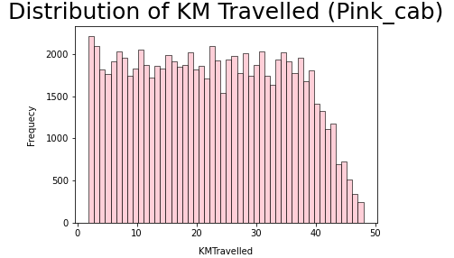
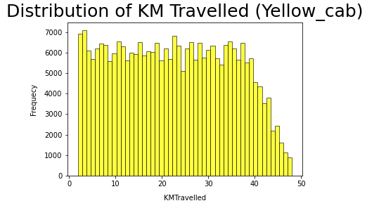
Distance travelled by both Cab is almost same

Slide 9
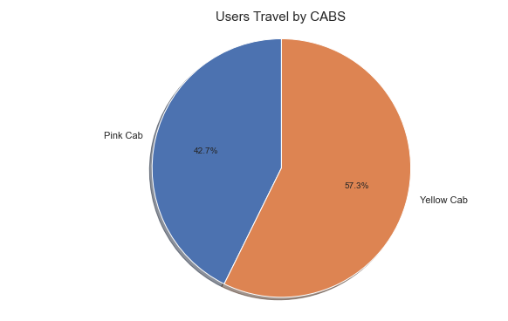
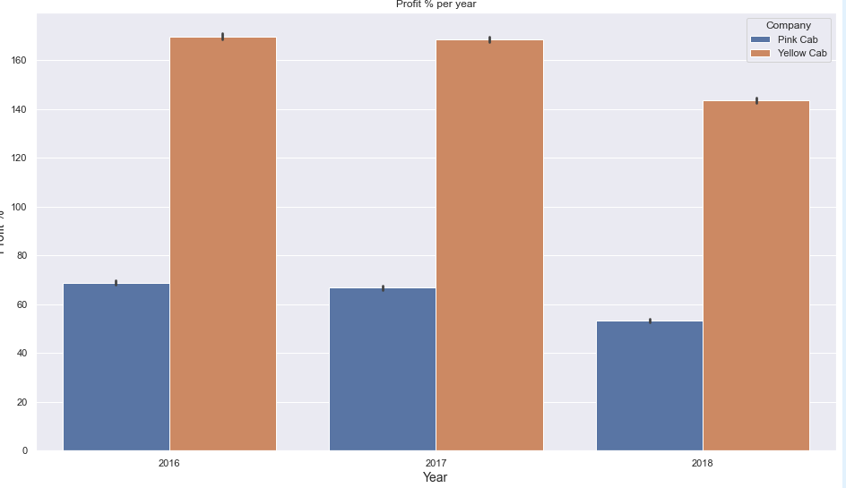
More Users more Profit

Slide 10
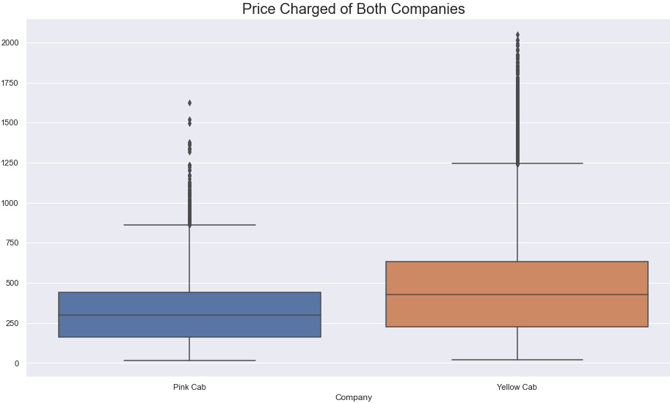
Comparison of prices between pink and yellow cab

Slide 11
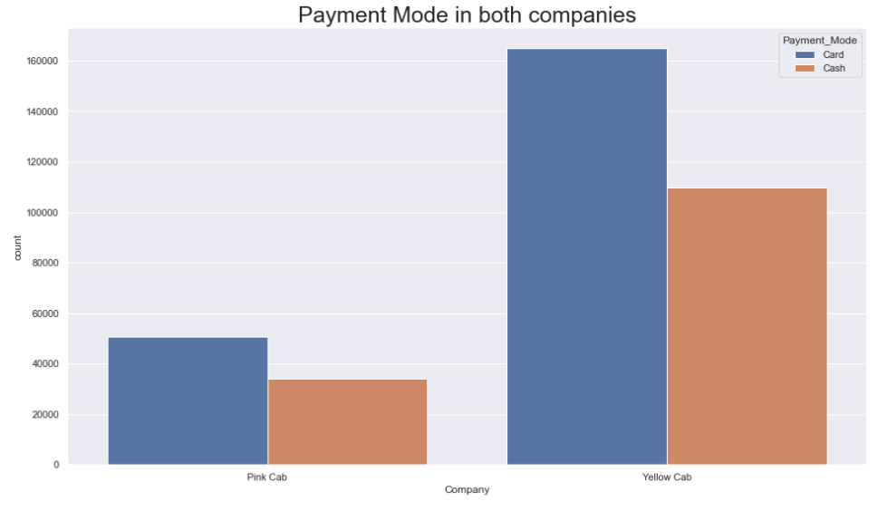
Mode of Payment

Slide 12
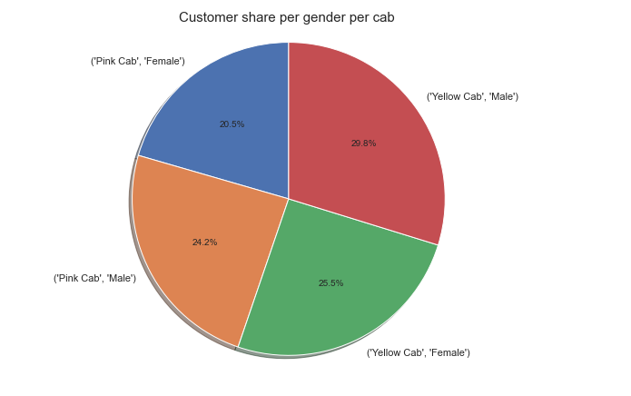
Male V/s Female Users

Slide 13
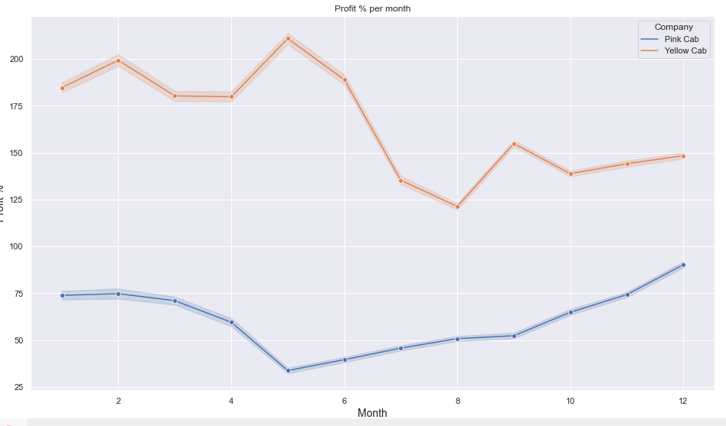
Profit per month

Slide 14
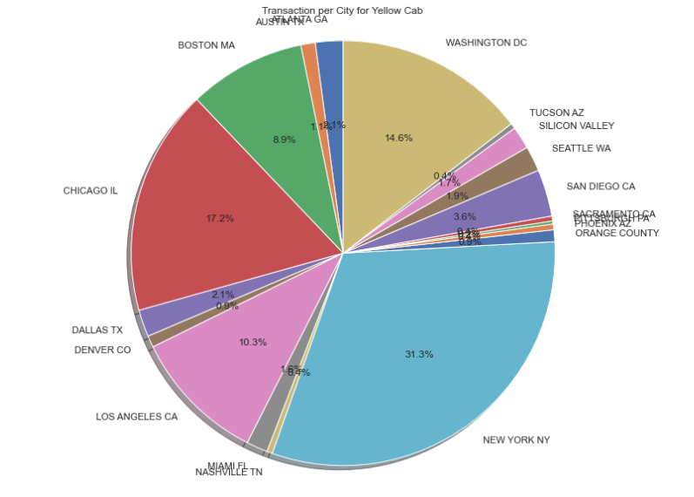
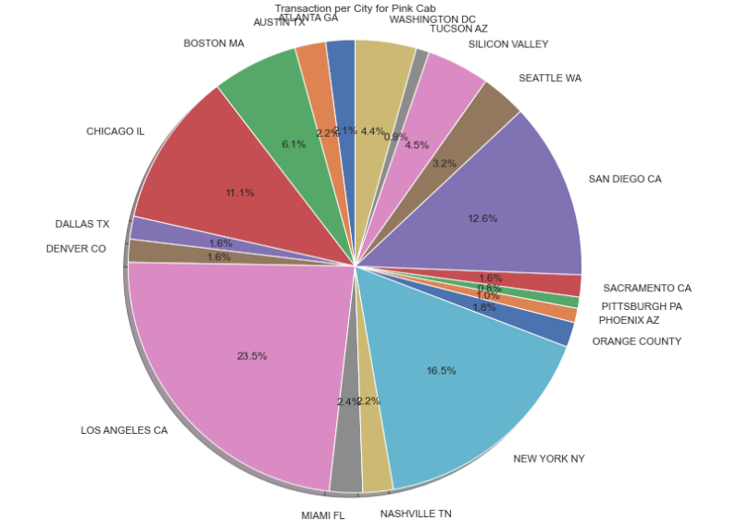
Comparison of Users in different cities

Slide 15
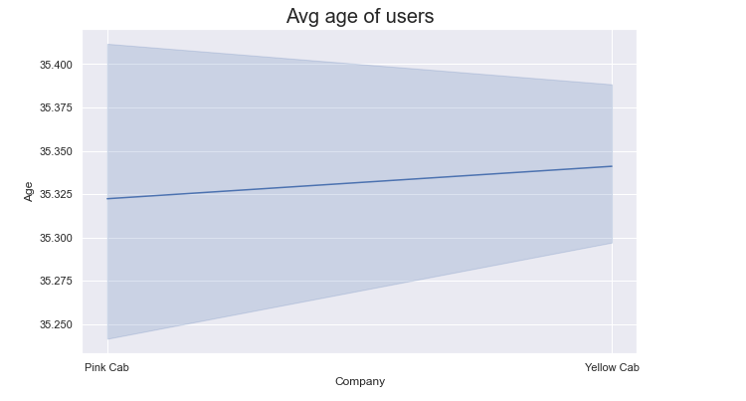
Average age of the users
The average age for the users are 35

Slide 16
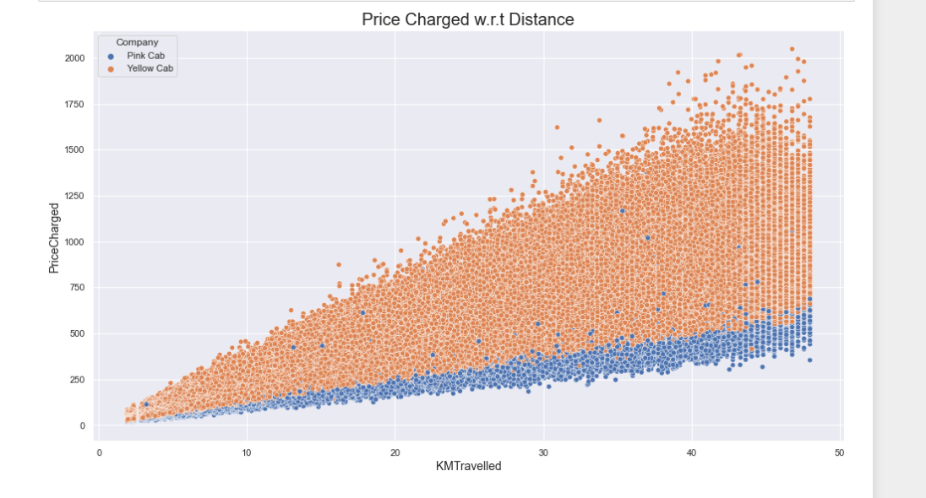
Price v/s Km travelled

Slide 17
Hypothesis 1 Is there any difference between cash or card payment on Profit H0----- There is no difference for cash or card payment H1-----There is a difference for cash payment and card payment
PINK CAB
P value is 0.7900465828793288
We accept null hypothesis H0 that there is no statistical difference
YELLOW CAB
P value is 0.2933060638298729
We accept null hypothesis H0 that there is no statistical difference
Conclusion:There is no difference in payment mode for both cab companies

Slide 18
Hypothesis 2 December is a good month for Profit than November H0----- December is a good month for Business than November H1---December is not a good month for Business than November
PINK CAB
P value is 0.23903944514341485
We accept null hypothesis H0 that there is no statistical difference
YELLOW CAB
P value is 0.7846822889997085
We accept null hypothesis H0 that there is no statistical difference
Conclusion:December is better than November due to Holidays

Slide 19
Hypothesis 3 Is there any difference regarding gender in Profit H0----Profit remain the same regarding Gender for both Yellow Cab and Pink Cab H1-----Profit will not remain the same regarding Gender for both Yellow Cab & Pink Cab
PINK CAB
P value is 0.11515305900425798
We accept null hypothesis H0 that there is no statistical difference
YELLOW CAB
P value is 6.060473042494144e-25
We accept Alternate hypothesis H1 that there is statistical difference
Conclusion:There is no difference regarding Gender

Slide 20
Hypothesis 4 Is there any difference in Profit regarding Users Age H0------There is no difference regarding Age in both cab companies. H1-----There is difference regarding Age in both cab companies.
PINK CAB
P value is 0.4816748536155635
We accept null hypothesis H0 that there is no statistical difference
YELLOW CAB
P value is 6.328485471267631e-05
We accept alternate hypothesis H1 that there is statistical difference
Conclusion:there is a difference in Profit regarding age Older people get discount

Slide 21
Conclusion
YELLOW CAB is better for Business Prospects than Pink cab
Profit=High
Users=More
Transactions=More

Slide 22
THANK YOU

